Slide 1
Chapter (8)
Strategic Planning

Slide 2
Introduction
It involved the use of formal and systematic design techniques. It concentrated on long-term plans and not concerned with implementation.
It ignores the human element. It is also based on quantitative aspect and focused externally.
Later writers emphasized on human and qualitative aspect of strategy. They saw “strategy” as evolutionary. It showed that “organizational behavior” as part of organizational processes.

Slide 3
Strategic Planning – Meaning
Strategic planning means planning for strategies and implementing them to achieve organizational goals.
It starts by asking oneself simple questions like What are we doing? Should we continue to do it or change our product line or the way of working? What is the impact of social, political, technological and other environmental factors on our operations? Are we prepared to accept these changes etc.?
Strategic planning helps in knowing what we are and where we want to go so that environmental threats and opportunities can be exploited, given the strengths and weaknesses of the organization. Strategic planning is “a thorough self examination regarding the goals and means of their accomplishment so that the enterprise is given both direction and cohesion.”

Slide 4
Strategic Planning – Definition
Strategic planning is the process of determining a company’s long-term goals and then identifying the best approach for achieving those goals.
Strategic planning is an organization’s process of defining its strategy or direction and making decisions on allocating its resources to pursue this strategy, including its capital and people.

Slide 5
Strategic Planning – Definition
Defining Mission Statement:
The mission statement is a short, concise statement that describes what the organization will strive to bring about the reason why the company exists in terms of its impact on the rest of the world.
Defining Vision Statement:
One of the functions of strategic planning is to inspire people in the organization to work towards the creation of a new state of affairs. The vision is a means of describing this desired future, but it works best to inspire and motivate if it’s bright, in other words, a vision should be a “picture” of the future. The visioning process is usually the very first step in the strategic planning process.

Slide 6
Strategic Planning – Definition
Defining Role Statement:
The mission statement would focus on results and outcomes, while the role statement gets more into the “how’s”.
A good way to think about this is to first state your mission, add a byline to it, and then add a role.
For example, if the Mission of a startup organization is to “go where no man has gone before” there might be a set of role statements
Usually there will be more than one role statement.

Slide 7
Strategic Planning Goals
Once we established a vision, mission and role, and done internal and external scans, we should have enough information to set goals for the period that our strategic plan covers.
Goals in strategic planning can be either result oriented, or process oriented, although, it’s probably better to have results oriented goals. For example – increase share price by 5%, increase return on capital investments by 10%, reduce employee turnover by 10%, bring three new products to market, and register 3 new patents.
Bad and non-strategic goals are, for example, become the most regarded company in our field (too vague, hard to measure, improve customer service (vague), hire and retain more talented staff (vague).

Slide 8
Strategic Planning – Features
Process of Questioning:
It answers questions like where we are and where we want to go, what we are and what we should be.
Time Horizon:
It aims at long-term planning, keeping in view the present and future environmental opportunities. It helps organizations analyze their strengths and weaknesses and adapt to the environment. Managers should be farsighted to make strategic planning meaningful.
Pervasive Process:
It is done for all organizations, at all levels; nevertheless, it involves top executives more than middle or lower-level managers since top executives envision the future better than others.

Slide 9
Strategic Planning – Features
Focus of Attention:
It focuses organization’s strengths and resources on important and high-priority activities rather than routine and day-to-day activities. It reallocates resources from non-priority to priority sectors.
Continuous Process:
Strategic planning is a continuous process that enables organizations to adapt to the ever-changing, dynamic environment.
Co-Ordination:
It coordinates organizations internal environment with the external environment, financial resources with non- financial resources and short-term plans with long-term plans.

Slide 10
Difference Between Planning and Strategy
The most simple difference between strategy and planning Put very simply, imagine a box on the floor that represents your organization:
Strategy is choosing where to put the box, its size and even whether it is even a box.
Planning is working inside the box, deciding what to do about the choices that were made. Of course you still need action, executing those choices.
Another way of looking at it is
Strategy is about understanding your environment and making choices about what you will do. Think, if you like, of where and how to play.
Planning is about making choices about how to use the resources you have and the actions you will take to achieve the choices made inside your strategy.

Slide 11
Difference Between Planning and Strategy
Planning
It is “Thinking before the action takes place”.
It decides beforehand, what, when, how the task is to be accomplished.
It is not exactly same as strategy, which is nothing but “a comprehensive plan.”
The strategy is all about using a trick to gain success in a particular purpose.
It is the skill of managing affairs of the enterprise.

Slide 12
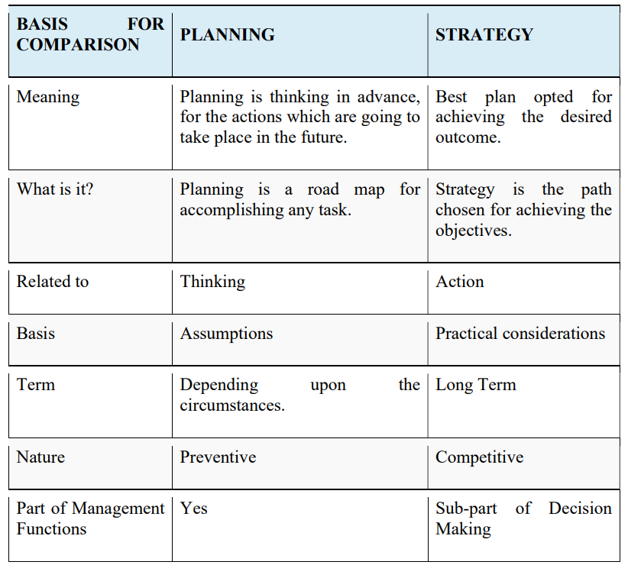
Difference Between Planning and Strategy

